Slide 1
Troubleshooting SQL Server Connection Issues

Slide 2
DB PowerStudio Maximize Database Performance, Visibility, and Insight
DB PowerStudio combines four innovative solutions
DBArtisan: Proactively manage space, state and performance with built-in analytics
DB Change Manager: Reveal, track, and report on database changes
Rapid SQL: Create high-performing SQL code on major DBMSs from one interface
DB Optimizer: Tune SQL like a pro with automated performance optimization suggestions
https://www.idera.com/dbpowerstudio-database-management-and-development-tools

Slide 3
@SQLSoldier
Database Engineer
BlueMountain Capital Management
PASS Security Virtual Chapter
http://security.sqlpass.org
Robert L Davis
Microsoft Certified Master
Data Platform MVP
Volunteers needed
www.sqlsoldier.com
16+ years working with SQL Server
Notes:
Database Engineer at BlueMountain Capital Management
Foremer Principal Database Architect at DB Best Technologies www.dbbest.com
Former Principal DBA at Outerwall, Inc
Former Sr. Product Consultant with Idera Software
Former Program Manager for SQL Server Certified Master program in Microsoft Learning
Former Sr. Production DBA / Operations Engineer at Microsoft (CSS)
Microsoft Certified Master: SQL Server 2008 / MCSM Charter: Data Platform
Co-founder of the SQL PASS Security Virtual Chapter
MCITP: Database Developer: SQL Server 2005 and 2008
MCITP: Database Administrator: SQL Server 2005 and 2008
MCSE: Data Platform
MVP 2014
Co-author of Pro SQL Server 2008 Mirroring
Former Idera ACE (Advisors & Community Educators)
2 time host of T-SQL Tuesday
Guest Professor at SQL University, summer 2010, spring/summer 2011
Speaker at SQL PASS Summit 2010, 2011, and 2012 including a pre-con in 2012
Speaker/Pre-con at SQLRally 2012
16+ years working with SQL Server
Writer for SQL Server Pro (formerly SQL Server Magazine)
Member: Mensa
Dog picture: Maggie and Woody
SQLCruise instructor: Seattle to Alaska 2012
Speaker at SQL Server Intelligence Conference in Seattle 2012
Blog: http://www.sqlsoldier.com
Twitter: http://twitter.com/SQLSoldier
SQL Server Best Practices: https://sqlbp.com/
SQLBP Twitter: @SQLBestPractice

Slide 4
Troubleshooting SQL Server Connection Issues

Slide 5
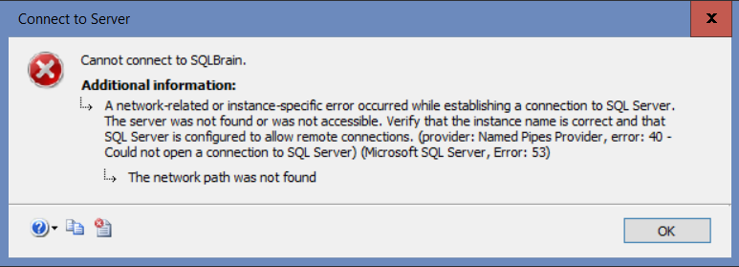
Troubleshooting SQL Server Connection Issues

Slide 6
Troubleshooting SQL Server Connection Issues

Slide 7
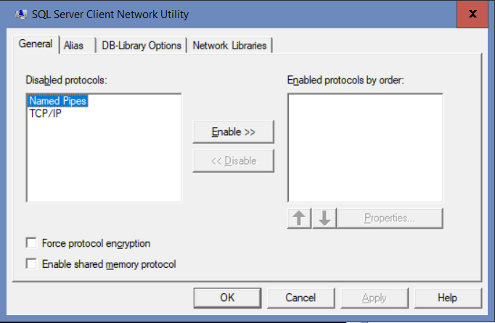
Troubleshooting SQL Server Connection Issues

Slide 8
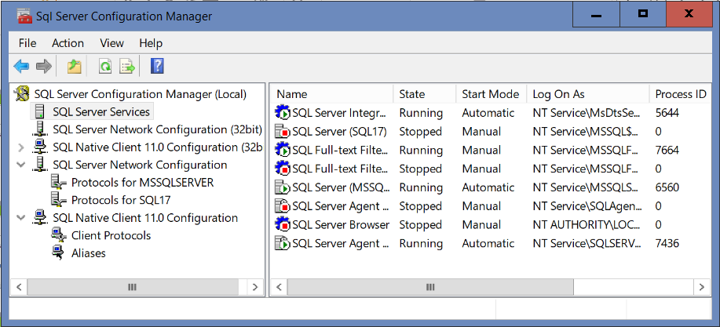
Troubleshooting SQL Server Connection Issues

Slide 9
Troubleshooting SQL Server Connection Issues

Slide 10
Troubleshooting SQL Server Connection Issues
Common connection issues

Slide 11
Troubleshooting SQL Server Connection Issues
Common connection issues
Server not reachable

Slide 12
Troubleshooting SQL Server Connection Issues
Common connection issues
Server not reachable
Login failure

Slide 13
Troubleshooting SQL Server Connection Issues
Common connection issues
Server not reachable
Login failure
Connection timed out

Slide 14
Troubleshooting SQL Server Connection Issues
Server not reachable

Slide 15
Troubleshooting SQL Server Connection Issues
Server not reachable
Firewall blocking

Slide 16
Troubleshooting SQL Server Connection Issues
Server not reachable
Firewall blocking
Local firewall

Slide 17
Troubleshooting SQL Server Connection Issues
Server not reachable
Firewall blocking
Local firewall
On both servers

Slide 18
Troubleshooting SQL Server Connection Issues
Server not reachable
Firewall blocking
Local firewall
On both servers
Firewall rules added?

Slide 19
Troubleshooting SQL Server Connection Issues
Server not reachable
Firewall blocking
Local firewall
On both servers
Firewall rules added?
Add port rules on SQL Server machine

Slide 20
Troubleshooting SQL Server Connection Issues
Server not reachable
Firewall blocking
Local firewall
On both servers
Firewall rules added?
Add port rules on SQL Server machine
Add program rules for remote machine

Slide 21
Troubleshooting SQL Server Connection Issues
Server not reachable
Firewall blocking
Local firewall
On both servers
Firewall rules added?
Add port rules on SQL Server machine
Add program rules for remote machine
Correct port?

Slide 22
Troubleshooting SQL Server Connection Issues
Server not reachable
Firewall blocking
Local firewall
On both servers
Firewall rules added?
Add port rules on SQL Server machine
Add program rules for remote machine
Correct port?
Rule defined for both incoming and outgoing

Slide 23
Troubleshooting SQL Server Connection Issues
Server not reachable
Firewall blocking
Local firewall
On both servers
Firewall rules added?
Add port rules on SQL Server machine
Add program rules for remote machine
Correct port?
Rule defined for both incoming and outgoing
Disable temporarily to validate firewall is issue

Slide 24
Troubleshooting SQL Server Connection Issues
Server not reachable
Firewall blocking
Network (corporate firewall)

Slide 25
Troubleshooting SQL Server Connection Issues
Server not reachable
Firewall blocking
Network (corporate firewall)
Contact your networking team to see if there are any network firewalls that may be blocking certain machines or IP ranges from accessing the SQL Server machines

Slide 26
Troubleshooting SQL Server Connection Issues
Server not reachable
Server not found

Slide 27
Troubleshooting SQL Server Connection Issues
Server not reachable
Server not found
Ping from remote server

Slide 28
Troubleshooting SQL Server Connection Issues
Server not reachable
Server not found
Ping from remote server
Does it respond?

Slide 29
Troubleshooting SQL Server Connection Issues
Server not reachable
Server not found
Ping from remote server
Does it respond?
Does it return the correct address?

Slide 30
Troubleshooting SQL Server Connection Issues
Server not reachable
Server not found
Ping from remote server
Does it respond?
Does it return the correct address?
Nslookup will return IP address as well

Slide 31
Troubleshooting SQL Server Connection Issues
Server not reachable
Server not found
Ping from remote server
Does it respond?
Does it return the correct address?
Nslookup will return IP address as well
Nslookup will return name for IP address too

Slide 32
Troubleshooting SQL Server Connection Issues
Server not reachable
Server not found
Ping from remote server
Does it respond?
Does it return the correct address?
Nslookup will return IP address as well
Nslookup will return name for IP address too
If other app failing (e.g., custom app), try connecting from remote server using SSMS or SQLCmd or PowerShell

Slide 33
Troubleshooting SQL Server Connection Issues
Server not reachable
Server not found
Ping from remote server
Does it respond?
Does it return the correct address?
Nslookup will return IP address as well
Nslookup will return name for IP address too
If other app failing (e.g., custom app), try connecting from remote server using SSMS or SQLCmd or PowerShell

Slide 34
Troubleshooting SQL Server Connection Issues
Server not reachable
Server not found
Check local hosts file

Slide 35
Troubleshooting SQL Server Connection Issues
Server not reachable
Server not found
Check local hosts file
%SystemRoot%\System32\drivers\etc\hosts

Slide 36
Troubleshooting SQL Server Connection Issues
Server not reachable
Server not found
Check local hosts file
%SystemRoot%\System32\drivers\etc\hosts
Check client aliases

Slide 37
Troubleshooting SQL Server Connection Issues
Server not reachable
Server not found
Check local hosts file
%SystemRoot%\System32\drivers\etc\hosts
Check client aliases
SQL Server Configuration Manager (SSCM)

Slide 38
Troubleshooting SQL Server Connection Issues
Server not reachable
Server not found
Check local hosts file
%SystemRoot%\System32\drivers\etc\hosts
Check client aliases
SQL Server Configuration Manager (SSCM)
SQL Server Client Network Utility

Slide 39
Troubleshooting SQL Server Connection Issues
Server not reachable
Server not found
Check local hosts file
%SystemRoot%\System32\drivers\etc\hosts
Check client aliases
SQL Server Configuration Manager (SSCM)
SQL Server Client Network Utility
Command line: cliconfg

Slide 40
Troubleshooting SQL Server Connection Issues
Server not reachable
Server not found
In same domain?

Slide 41
Troubleshooting SQL Server Connection Issues
Server not reachable
Server not found
In same domain?
Does domain trust exist?

Slide 42
Troubleshooting SQL Server Connection Issues
Server not reachable
Server not found
In same domain?
Does domain trust exist?
Can it authenticate to the domain of the user connecting?

Slide 43
Troubleshooting SQL Server Connection Issues
Server not reachable
Server not found
In same domain?
Does domain trust exist?
Can it authenticate to the domain of the user connecting?
Use fully qualified domain name (FQDN)

Slide 44
Troubleshooting SQL Server Connection Issues
Server not reachable
Server not found
In same domain?
Does domain trust exist?
Can it authenticate to the domain of the user connecting?
Use fully qualified domain name (FQDN)
Add domain suffix to DNS suffix list in TCP/IPv4 Properties

Slide 45
Troubleshooting SQL Server Connection Issues
Server not reachable
Server not found
Named instance?

Slide 46
Troubleshooting SQL Server Connection Issues
Server not reachable
Server not found
Named instance?
Is it running on port 1433?

Slide 47
Troubleshooting SQL Server Connection Issues
Server not reachable
Server not found
Named instance?
Is it running on port 1433?
Is SQLBrowser service running?

Slide 48
Troubleshooting SQL Server Connection Issues
Server not reachable
Server not found
Named instance?
Is it running on port 1433?
Is SQLBrowser service running?

Slide 49
Troubleshooting SQL Server Connection Issues
Server not reachable
Server not found
Named instance?
Is it running on port 1433?
Is SQLBrowser service running?
Are you specifying the port number if SQLBrowser not running?

Slide 50
Troubleshooting SQL Server Connection Issues
Server not reachable
Server not found
Named instance?
Is it running on port 1433?
Is SQLBrowser service running?
Are you specifying the port number if SQLBrowser not running?
Did you use backslash (\) and not forward slash (/)?

Slide 51
Troubleshooting SQL Server Connection Issues
Server not reachable
Do client and server have a protocol in common?

Slide 52
Troubleshooting SQL Server Connection Issues
Server not reachable
Do client and server have a protocol in common?
Remote client must have either TCP/IP and/or Named Pipes enabled and the server must have at least one matching protocol

Slide 53
Troubleshooting SQL Server Connection Issues
Server not reachable
Do client and server have a protocol in common?
Remote client must have either TCP/IP and/or Named Pipes enabled and the server must have at least one matching protocol
Use SSCM on server

Slide 54
Troubleshooting SQL Server Connection Issues
Server not reachable
Do client and server have a protocol in common?
Remote client must have either TCP/IP and/or Named Pipes enabled and the server must have at least one matching protocol
Use SSCM on server
Use SSCM or cliconfg on client

Slide 55
Troubleshooting SQL Server Connection Issues
Server not reachable
Do client and server have a protocol in common?
Don’t be fooled by protocol reported in error

Slide 56
Troubleshooting SQL Server Connection Issues
Server not reachable
Do client and server have a protocol in common?
Don’t be fooled by protocol reported in error
If both tcp/ip and named pipes enabled at client, both protocols will be attempted before returning an error

Slide 57
Troubleshooting SQL Server Connection Issues
Server not reachable
Do client and server have a protocol in common?
Don’t be fooled by protocol reported in error
If both tcp/ip and named pipes enabled at client, both protocols will be attempted before returning an error
It will try them in order specified in client protocols and error will only mention the last one tried

Slide 58
Troubleshooting SQL Server Connection Issues
Server not reachable
Do client and server have a protocol in common?
Don’t be fooled by protocol reported in error
If both tcp/ip and named pipes enabled at client, both protocols will be attempted before returning an error
It will try them in order specified in client protocols and error will only mention the last one tried
Error indicates that all attempts failed

Slide 59
Troubleshooting SQL Server Connection Issues
Login failure
18456 error

Slide 60
Troubleshooting SQL Server Connection Issues
Login failure
18456 error
Logged in SQL log

Slide 61
Troubleshooting SQL Server Connection Issues
Login failure
18456 error
Logged in SQL log
Real reason often not returned to client

Slide 62
Troubleshooting SQL Server Connection Issues
Login failure
18456 error
Logged in SQL log
Real reason often not returned to client
State in error very important in troubleshooting

Slide 63
Troubleshooting SQL Server Connection Issues
Login failure
18456 error
Logged in SQL log
Real reason often not returned to client
State in error very important in troubleshooting
List of known causes for each state code maintained on Aaron Bertrand’s blog

Slide 64
Troubleshooting SQL Server Connection Issues
Login failure
18456 error
Logged in SQL log
Real reason often not returned to client
State in error very important in troubleshooting
List of known causes for each state code maintained on Aaron Bertrand’s blog
http://sqlblog.com/blogs/aaron_bertrand/archive/2011/01/14/sql-server-v-next-denali-additional-states-for-error-18456.aspx

Slide 65
Troubleshooting SQL Server Connection Issues
Connection timeout

Slide 66
Troubleshooting SQL Server Connection Issues
Connection timeout
Resource contention

Slide 67
Troubleshooting SQL Server Connection Issues
Connection timeout
Resource contention
CPU at or near 100%

Slide 68
Troubleshooting SQL Server Connection Issues
Connection timeout
Resource contention
CPU at or near 100%
Connection limit hit

Slide 69
Troubleshooting SQL Server Connection Issues
Connection timeout
Resource contention
CPU at or near 100%
Connection limit hit
Query sys.dm_exec_connections

Slide 70
Troubleshooting SQL Server Connection Issues
Connection timeout
Resource contention
CPU at or near 100%
Connection limit hit
Query sys.dm_exec_connections
Connection_id is smallint = 32,767 max connections

Slide 71
Troubleshooting SQL Server Connection Issues
Connection timeout
Resource contention
CPU at or near 100%
Connection limit hit
Query sys.dm_exec_connections
Connection_id is smallint = 32,767 max connections
Worker thread exhaustion

Slide 72
Troubleshooting SQL Server Connection Issues
Connection timeout
Resource contention
CPU at or near 100%
Connection limit hit
Query sys.dm_exec_connections
Connection_id is smallint = 32,767 max connection
Worker thread exhaustion
More common with database mirroring or Availability Groups

Slide 73
Troubleshooting SQL Server Connection Issues
Connection timeout
Resource contention
CPU at or near 100%
Connection limit hit
Query sys.dm_exec_connections
Connection_id is smallint = 32,767 max connection
Worker thread exhaustion
More common with database mirroring or Availability Groups
Can increase worker threads if all other resource usage is low

Slide 74
Troubleshooting SQL Server Connection Issues
Connection timeout
Resource contention
CPU at or near 100%
Connection limit hit
Query sys.dm_exec_connections
Connection_id is smallint = 32,767 max connection
Worker thread exhaustion
More common with database mirroring or Availability Groups
Can increase worker threads if all other resource usage is low
Memory pressure

Slide 75
Troubleshooting SQL Server Connection Issues
Connection timeout
Resource contention
CPU at or near 100%
Connection limit hit
Query sys.dm_exec_connections
Connection_id is smallint = 32,767 max connection
Worker thread exhaustion
More common with database mirroring or Availability Groups
Can increase worker threads if all other resource usage is low
Memory pressure
Error that connection object couldn’t be created due to memory pressure

Slide 76
Troubleshooting SQL Server Connection Issues
Query connection count:
-- Number of connections
Select count(*) As Connections
From sys.dm_exec_connections;
Query thread usage:
-- Threads by CPU
Select S.cpu_id As CPUID, count(*) As Threads
From sys.dm_os_threads As T
Inner Join sys.dm_os_schedulers As S
On S.scheduler_address = T.scheduler_address
Group By S.cpu_id;
-- Threads by NUMA Nodes
Select S.parent_node_id As NUMANode, count(*) As Threads
From sys.dm_os_threads As T
Inner Join sys.dm_os_schedulers As S
On S.scheduler_address = T.scheduler_address
Group By S.parent_node_id;

Slide 77
Troubleshooting SQL Server Connection Issues
Connection timeout

Slide 78
Troubleshooting SQL Server Connection Issues
Connection timeout
Used to be logged in the SQL log

Slide 79
Troubleshooting SQL Server Connection Issues
Connection timeout
Used to be logged in the SQL log
Current versions: logged in the ring buffer instead of log

Slide 80
Troubleshooting SQL Server Connection Issues
Connection timeout
Used to be logged in the SQL log
Current versions: logged in the ring buffer instead of log
If not logged in SQL log or ring buffer, the connection attempt never reached SQL Server

Slide 81
Troubleshooting SQL Server Connection Issues
Connection timeout
Used to be logged in the SQL log
Current versions: logged in the ring buffer instead of log
If not logged in SQL log or ring buffer, the connection attempt never reached SQL Server
See Server not reachable section covered earlier

Slide 82
Troubleshooting SQL Server Connection Issues
Connection timeout
Used to be logged in the SQL log
Current versions: logged in the ring buffer instead of log
If not logged in SQL log or ring buffer, the connection attempt never reached SQL Server
See Server not reachable section covered earlier
Query sys.dm_os_ring_buffers where ring_buffer_type = RING_BUFFER_CONNECTIVITY

Slide 83
Troubleshooting SQL Server Connection Issues
Connection timeout
Used to be logged in the SQL log
Current versions: logged in the ring buffer instead of log
If not logged in SQL log or ring buffer, the connection attempt never reached SQL Server
See Server not reachable section covered earlier
Query sys.dm_os_ring_buffers where ring_buffer_type = RING_BUFFER_CONNECTIVITY
Download from pastebin: https://pastebin.com/epSp2yUD

Slide 84
Troubleshooting SQL Server Connection Issues
Connection timeout
Used to be logged in the SQL log
Current versions: logged in the ring buffer instead of log
If not logged in SQL log or ring buffer, the connection attempt never reached SQL Server
See Server not reachable section covered earlier
Query sys.dm_os_ring_buffers where ring_buffer_type = RING_BUFFER_CONNECTIVITY
Download from pastebin: https://pastebin.com/epSp2yUD

Slide 85
Thanks!
Thank you for attending!
My blog: www.sqlsoldier.com
Twitter: @SQLSoldier
SQL Server Best Practices: sqlbp.com
SQLBP Twitter: @SQLBestPractice

